Slide 1

RFI Management in the REACH Pipeline
Samuel A K Leeney

Slide 2

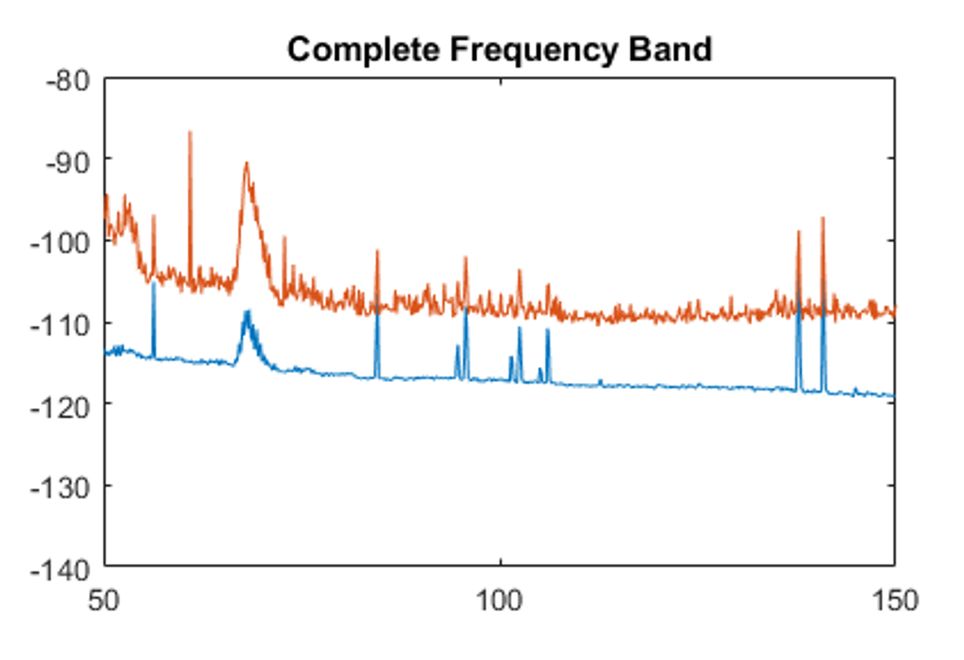
The Problem
RFI x orders of mag stronger than 21cm signal.
21cm signal obstructed by wide and short band RFI.
Single frequency and emergency mobile signals particularly worrying.

Slide 3
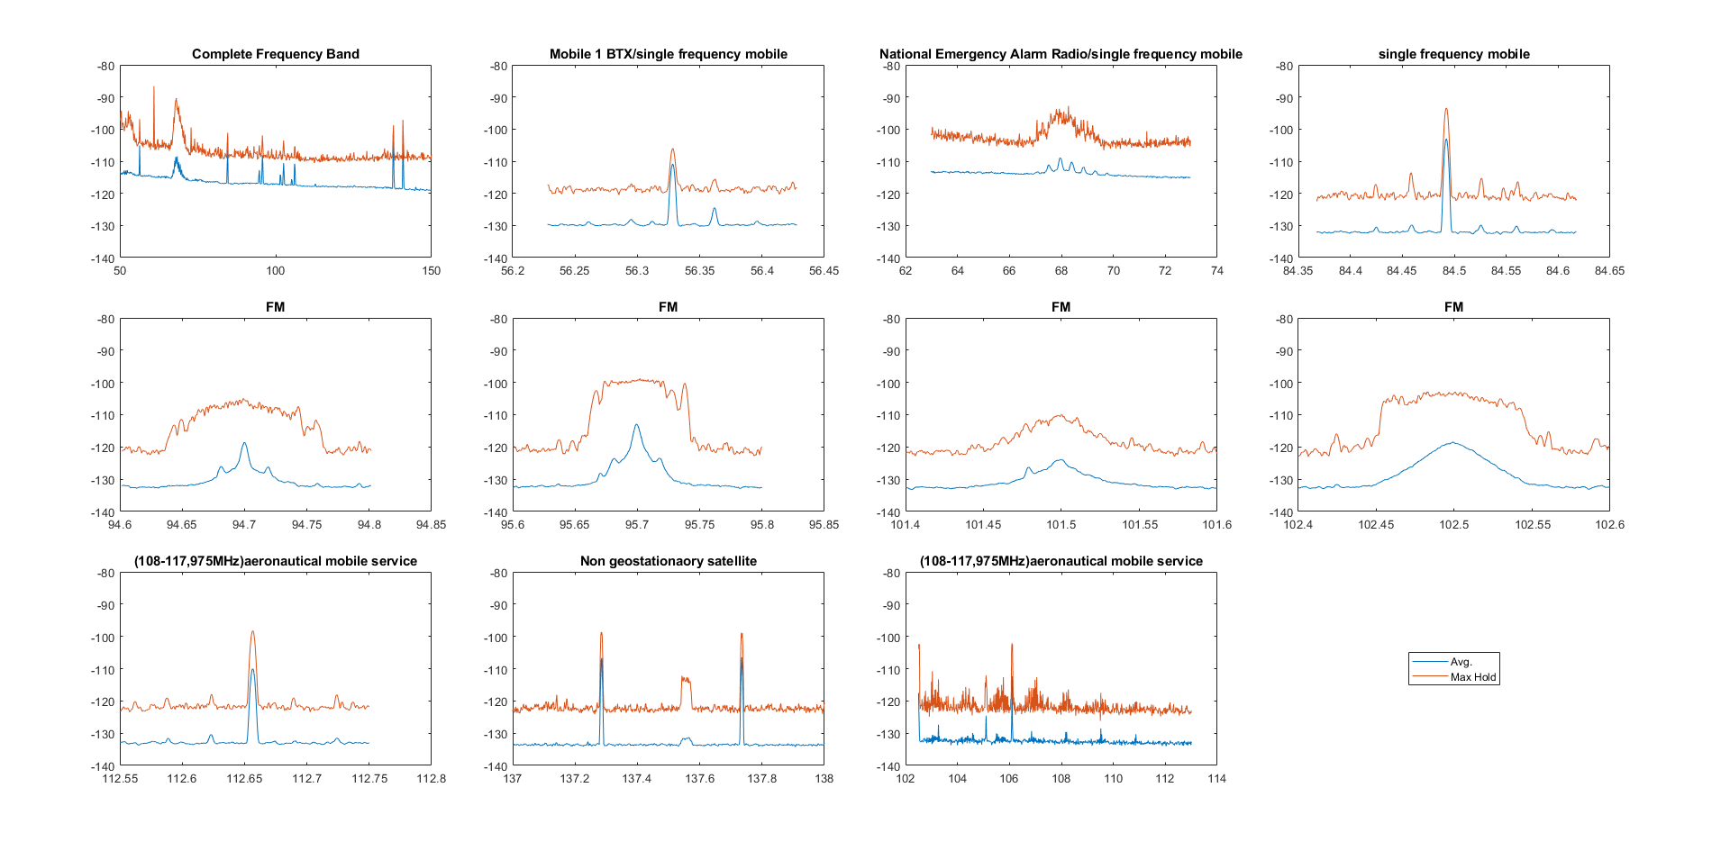
The Problem

Slide 4
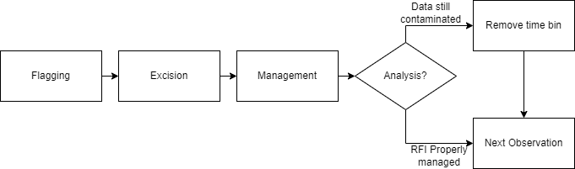
Basic Process

Slide 5
Excision + Management i) -Overview
For now, we assume ‘perfect’ flagging.
3 possible approaches:
Excision + Inpainting
Excision + Polychord
Polychord Only

Slide 6
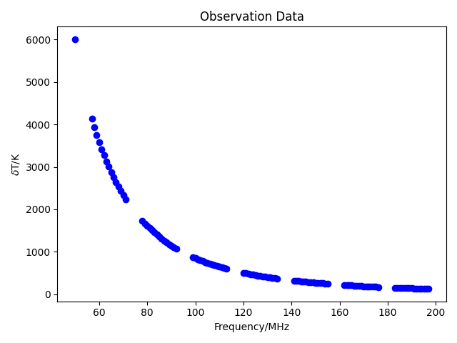
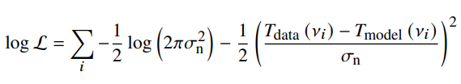
Excision + Management ii) -How do we manage data excision?
Delete frequency bins containing RFI.
Sum likelihood pdfs of remaining frequency bins.
Parameter estimation and Bayesian evidence calculation using Polychord.

Slide 7
Excision + Management iii) -How much data can we lose?

Slide 8
Excision + Management iv) -How much data can we lose?

Slide 9
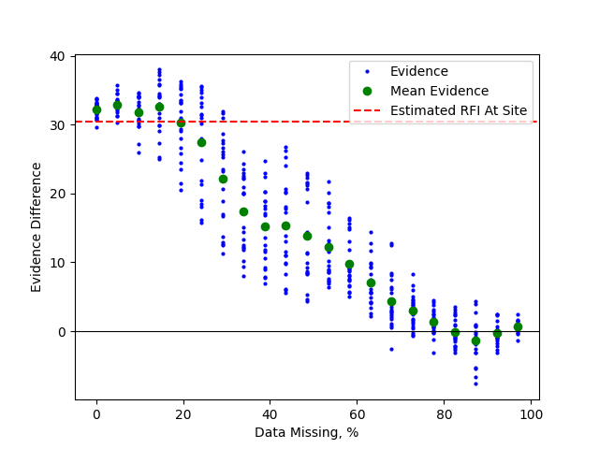
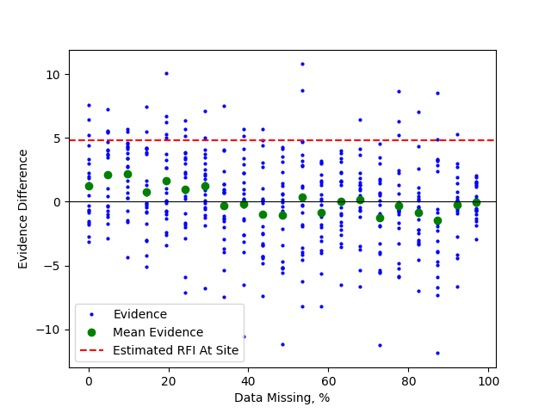
Excision + Management v) -How much data can we lose (Evidence Difference)?
Spiral
Dipole

Slide 10
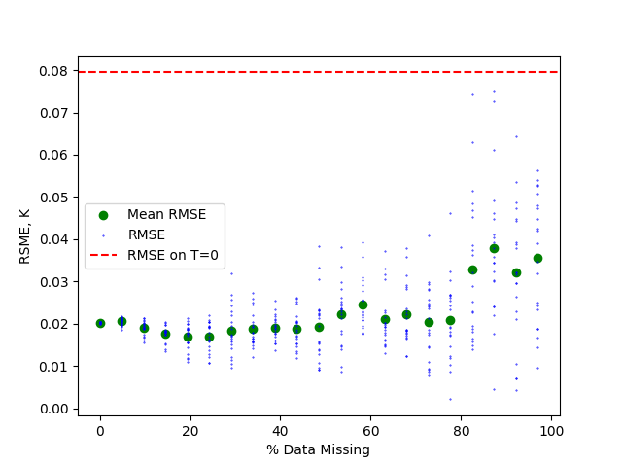
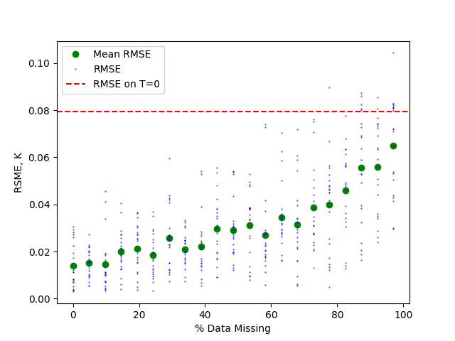
Excision + Management vi) -How much data can we lose (RMSE)?
Spiral
Dipole

Slide 11
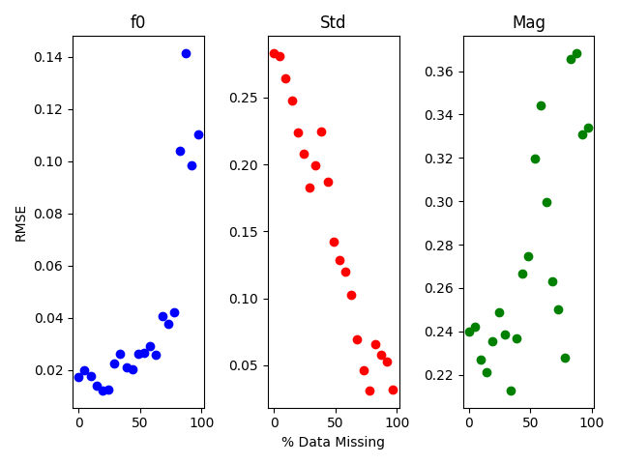
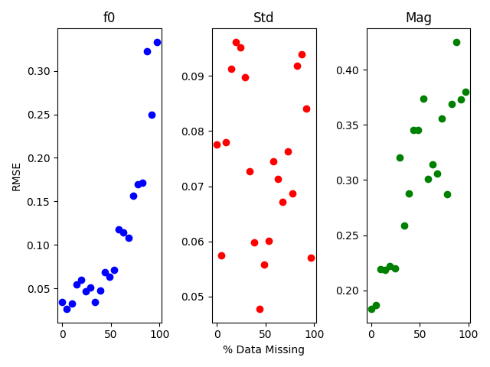
Excision + Management vii) -How much data can we lose?
Spiral
Dipole

Slide 12
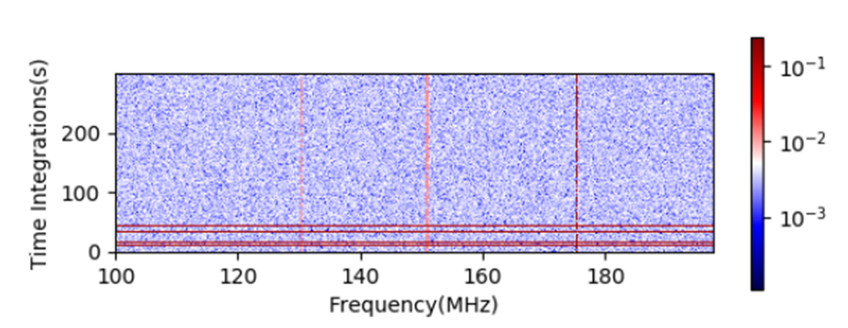
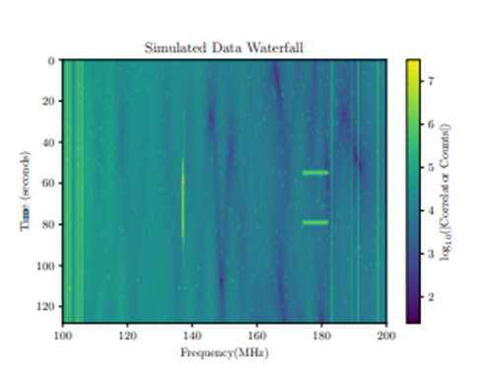
Flagging i) -Types of RFI?
Constant in time, narrowband.
Temporary, broadband.
Can be problematic if >20% of data missing.
Temporary, narrowband.
If flagged, can be dealt with
If unflagged is a major problem.
[Images courtesy of Z. Chen, 2021]

Slide 13
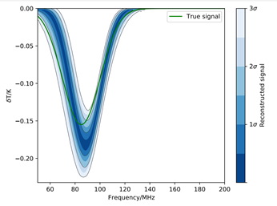
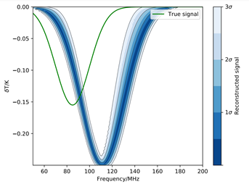
Flagging ii) -Temporary, narrowband.
Effect of 1Mhz unflagged RFI at 80Mhz

Slide 14
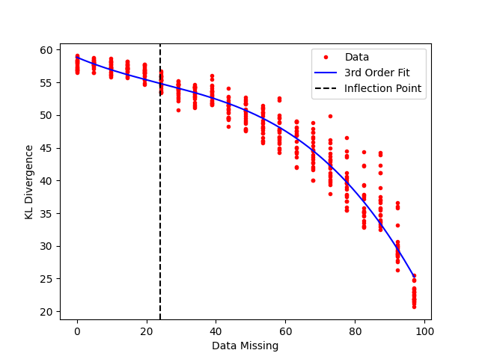
Flagging iii) -Automating the detection of ‘too contaminated’ observations?
The Kullback-Leibler divergence.
Quantifies information provided by our data.
Useful for:
Identifying time bins containing broadband RFI.
Unflagged narrowband RFI.

Slide 15
Next Steps?
Is short time narrowband RFI less of a problem when time integrating?
Experiment with various existing flagging models.
Recent papers use CNN’s to flag RFI [x][x].
Unsupervised learning?

Slide 16
Summary
Pipeline very effective at managing flagged RFI.
If RFI properly flagged, should be able to handle estimated levels on site.
Unflagged RFI may cause problems.
The pipelines efficacy will come down to our ability to effectively flag the RFI.

Slide 18


